Slide 1
Using R to Develop a Molecular Diagnostic for Coronary Artery Disease
Mike Elashoff
Bay Area R, May 11, 2010
Not approved for use with healthcare providers

Slide 2
Genomic Test for Coronary Artery Disease
Intersection of three hard problems
Clinical
Biological
Statistical
Our clinical trial
Statistical methods
Results
Translating an algorithm into a product

Slide 3
Clinical Background
Clinical
Biological
Statistical
Our clinical trial
Discovery
Gene selection
Term selection
Model fitting
Results
Product
Coronary artery disease (CAD) is the leading cause of death in the US; 500,000 new cases per year
Definitive diagnosis by invasive coronary angiography
Diagnosis of interest: obstructive disease
>=50% blockage (stenosis) of a coronary artery

Slide 4
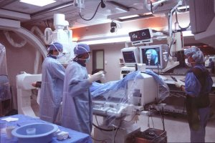
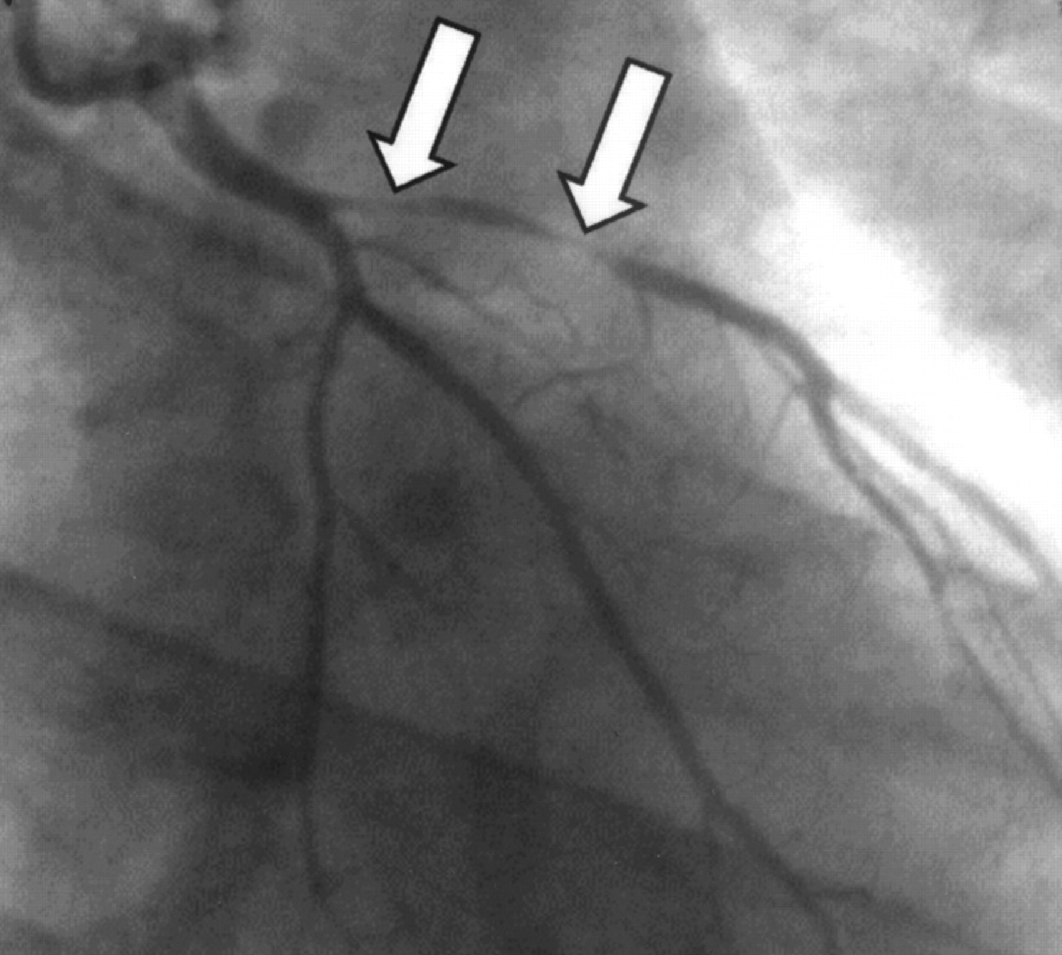
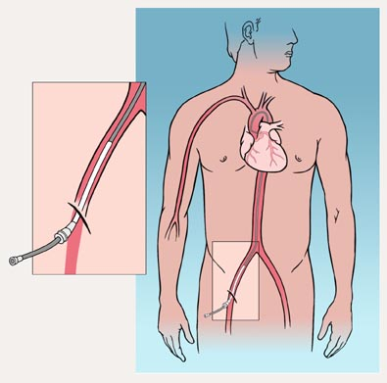
Coronary Angiography (Cath)
cath tip at
coronary ostia
sheath in
femoral artery

Slide 5
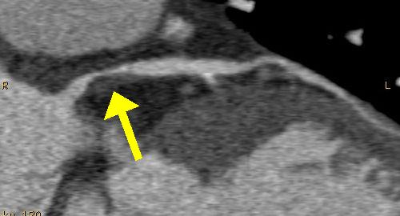
Non-Invasive Imaging
MPI
CTA

Slide 6

Non-Invasive Imaging
Clinical
Biological
Statistical
Our clinical trial
Discovery
Gene selection
Term selection
Model fitting
Results
Product
N = 400,000
Two-thirds of patients who have coronary angiography do not have obstructive CAD
∆AUC for diagnostic imaging = 0.3%

Slide 7
Biological Background
Clinical
Biological
Statistical
Our clinical trial
Discovery
Gene selection
Term selection
Model fitting
Results
Product
DNA -> RNA -> Protein
Genetics: easy to measure lots of data accurately, static
Gene expression: moderate to measure lots of data accurately, dynamic
Proteins: hard to measure lots of data accurately, dynamic
Gene expression technologies:
Microarrays measure expression of ~50,000 RNA’s
PCR measures expression of individual RNA’s
Can’t do much better than ± 10%

Slide 8
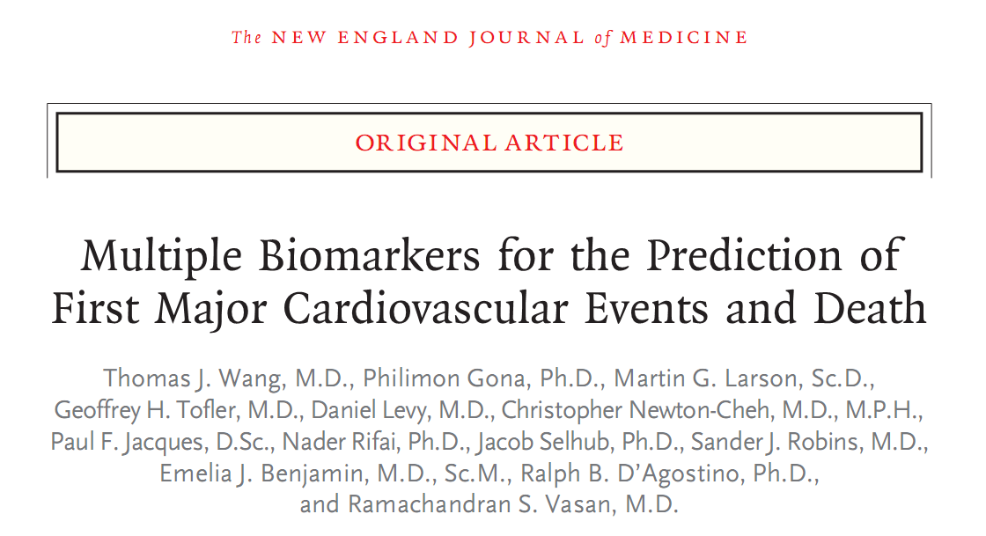
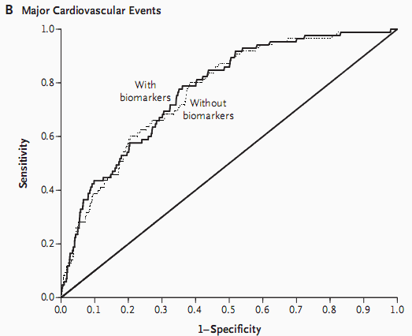
Clinical
Biological
Statistical
Our clinical trial
Discovery
Gene selection
Term selection
Model fitting
Results
Product

Slide 9
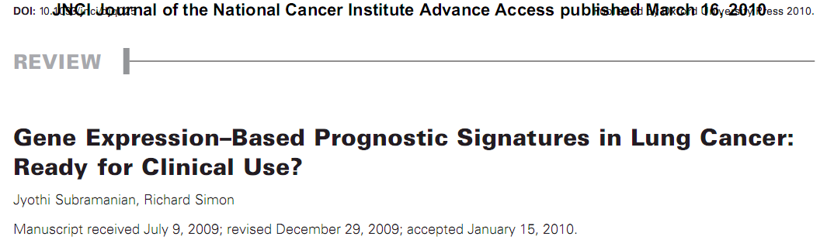
Clinical
Biological
Statistical
Our clinical trial
Discovery
Gene selection
Term selection
Model fitting
Results
Product

Slide 10
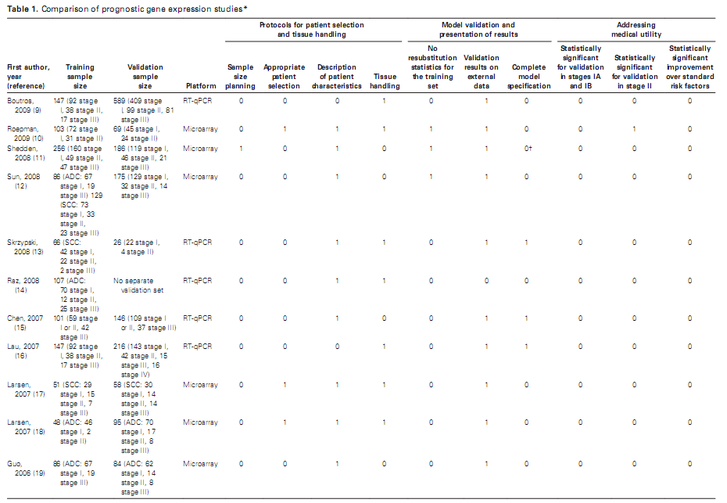
Statistically significant improvement over standard risk factors
0/16 studies

Slide 11
Prospective Clinical Trial: PREDICT
Clinical
Biological
Statistical
Our clinical trial
Discovery
Gene selection
Term selection
Model fitting
Results
Product
Enrollment at the time of invasive coronary angiography
Collect:
Clinical data
Blood samples for gene expression
Invasive angiography results/films
Powered to detect ∆AUC of 5%

Slide 12
Clinical Data Monitoring
Clinical
Biological
Statistical
Our clinical trial
Discovery
Gene selection
Term selection
Model fitting
Results
Product
Upfront simulation to estimate allowable error rate: 2.5%
2000 patients, 100 monitored fields/patient
200,000 fields checked
~15,000 corrections (7.5% error rate)

Slide 13
Computerized Assessment of Angiography
Clinical
Biological
Statistical
Our clinical trial
Discovery
Gene selection
Term selection
Model fitting
Results
Product
Sent invasive angiography films to a core laboratory for computerized assessment (QCA)
Compare maximal blockage
Clinic read
QCA computerized read

Slide 14
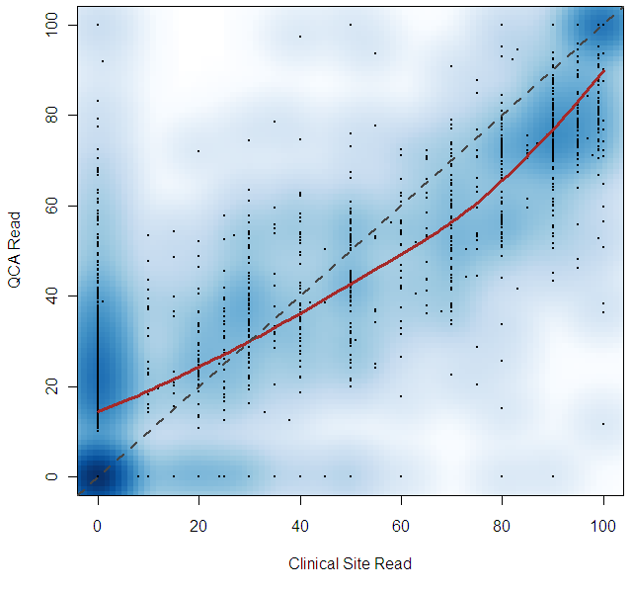
QCA
geneplotter library
smoothScatter(MaxSten,QCAMaxSten,nrpoints=2000,nbin=100,pch=16,
cex=.33,ylab="QCA Read",xlab="Clinical Site Read")
model1<-loess(QCAMaxSten~MaxSten) lines(0:100,predict(model1,newdata=data.frame(MaxSten=c(0:100))),col=2,lwd=3)

Slide 15
Algorithm Development (3 years in 4 bullets)
50,000 genes (Microarray)
~100 genes (PCR)
~10 terms
1 algorithm

Slide 16
Discovery: Paired Microarray (N=250)
pairmatch (optmatch package)
array normalization/QC, many methods/libraries
clogit (survival package)
Clinical
Biological
Statistical
Our clinical trial
Discovery
Gene selection
Term selection
Model fitting
Results
Product
m.dist<-function(x,y,age.max=10){
a <- 0
if(x$SEX!=y$SEX) a <- Inf
a <- a+2*abs(x$AGE-y$AGE)
if(abs(x$AGE-y$AGE)>age.max) a <- Inf
a <- a+ifelse(x$Center!=y$Center,10,0)
a
}
clogit(CaseControl~GeneExp+strata(Pairs),data=clin )

Slide 17
Paired Array Analysis
Clinical
Biological
Statistical
Our clinical trial
Discovery
Gene selection
Term selection
Model fitting
Results
Product
heatmap2 (gplots package)

Slide 18
Algorithm Development (PCR, N=600)
Clinical
Biological
Statistical
Our clinical trial
Discovery
Gene selection
Term selection
Model fitting
Results
Product
“The first principle is that you must not fool yourself and you are the easiest person to fool.”
Richard Feynman
glmrob (robustbase package)
Gene set/pathway analyses of limited utility
glmrob(Disease~SEX+AGE+pcr.dat[,i],family=binomial(link=logit))

Slide 19
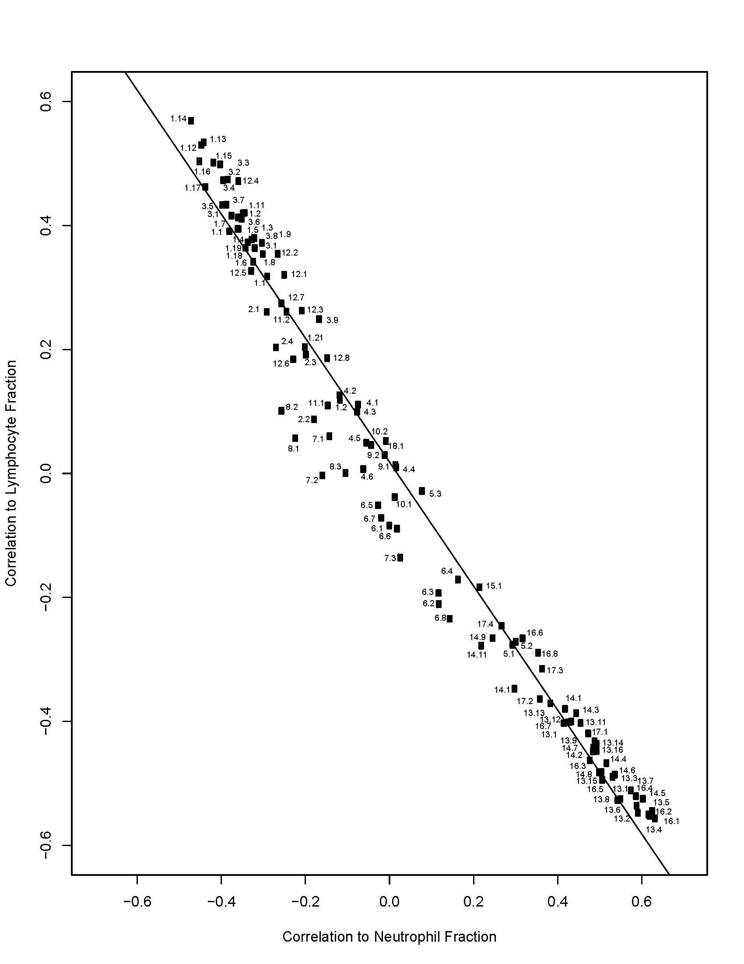
Clinical
Biological
Statistical
Our clinical trial
Discovery
Gene selection
Term selection
Model fitting
Results
Product
Correlation to Lymphocyte%
Correlation to Neutrophil%

Slide 20
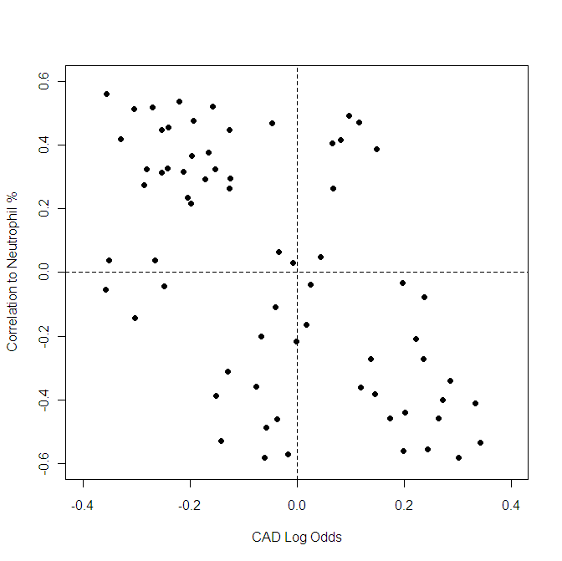
Neutrophil Activation/Necrosis
Clinical
Biological
Statistical
Our clinical trial
Discovery
Gene selection
Term selection
Model fitting
Results
Product
Neutrophil Activation/Apoptosis
Normalization
Neutrophil/Lymphocyte Ratio
Eosinophil
Unknown
T Cell
NK Cell
B Cell
Disease Association

Slide 21
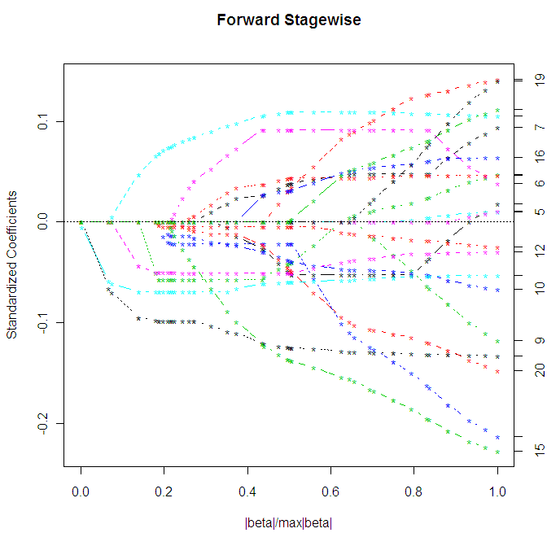
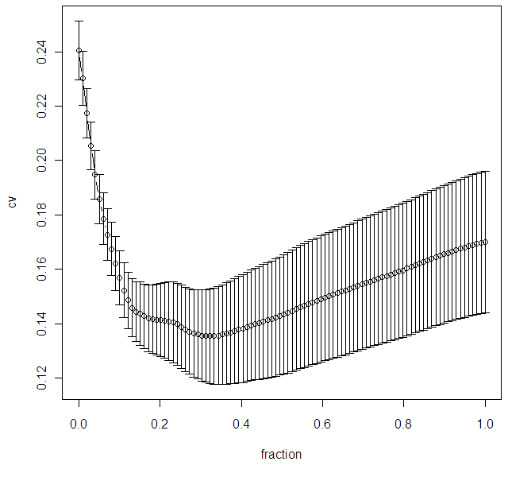
LASSO for Variable Selection
null model
full model
best model
lars package
lars(as.matrix(pred.dat),clin$Disease,type="for")
cv.lars(as.matrix(pred.dat),clin$Disease,type="for")

Slide 22
Algorithm Terms and Genes
Males Females
1)Neutrophil Activation - Apoptosis
Innate Immunity
(IL18RAP+TNFAIP6+CASP5) -
(IL8RB+TNFRSF10C+TLR4+KCNE3)
2M)Neutrophil Activation/Lymphocytes
Innate Immunity/Cell Necrosis
(S100A8+S100A12+CLEC4E) - RPL28
3)NK Activation/T cells
Innate Immunity
(SLAMF7+KLRC4) - (TMC8+CD3D)
4)B/T Ratio - Adaptive Immune Response
(SPIB+CD79B) - (TMC8,CD3D)
5)AF2 - (TFCP2+HNRPF)
6M)TSPAN - (TFCP2+HNRPF)
1)Neutrophil Activation - Apoptosis
Innate Immunity
(IL18RAP+TNFAIP6+CASP5) -
(IL8RB+TNFRSF10C+TLR4+KCNE3)
2F)Normalized Neutrophil Activation
Innate Immunity/Cell Necrosis
(S100A8+S100A12+CLEC4E) -
(NCF4+AQP9)
3)NK Activation/T cells
Innate Immunity
(SLAMF7+KLRC4) - (TMC8+CD3D)
4)B/T Ratio - Adaptive Immune Response
(SPIB+CD79B) - (TMC8,CD3D)
5)AF2 - (TFCP2+HNRPF)
Clinical
Biological
Statistical
Our clinical trial
Discovery
Gene selection
Term selection
Model fitting
Results
Product

Slide 23
Ridge Regression
Clinical
Biological
Statistical
Our clinical trial
Discovery
Gene selection
Term selection
Model fitting
Results
Product
Frank Harrell’s Design package:
Model checking, cross validation, calibration etc.
Great
Not a substitute for independent validation
Design package
mod.rr<-lrm(out~SEX+F.AGE+M.AGE+term1s+term2s+term3s
+term4s+term5s+term6s+term7s,data=lasso.dat.s,
penalty=1,penalty.matrix=
diag(c(0,0,0,2*lam,2*lam,4*lam,0,2*lam,lam,lam)))

Slide 24
Penalized Regression Libraries
 | Logistic | Linear | Survival | Lasso | Ridge | Grouped Lasso
Design/rms | x | x |  |  | x (by term)
penalized | x | x | x | x | x
lars |  | x |  | x
glmnet | x | x | x | x | x
grplasso | x | x |  | x |  | x
MASS | x | x |  |  | x
grpreg | x | x |  | x |  | x
Others for penalized PCA, discriminant analysis, etc.

Slide 25
Validation
Clinical
Biological
Statistical
Our clinical trial
Discovery
Gene selection
Term selection
Model fitting
Results
Product
Locked algorithm, data handling rules, endpoints (external statistician)
N=526 patients

Slide 26
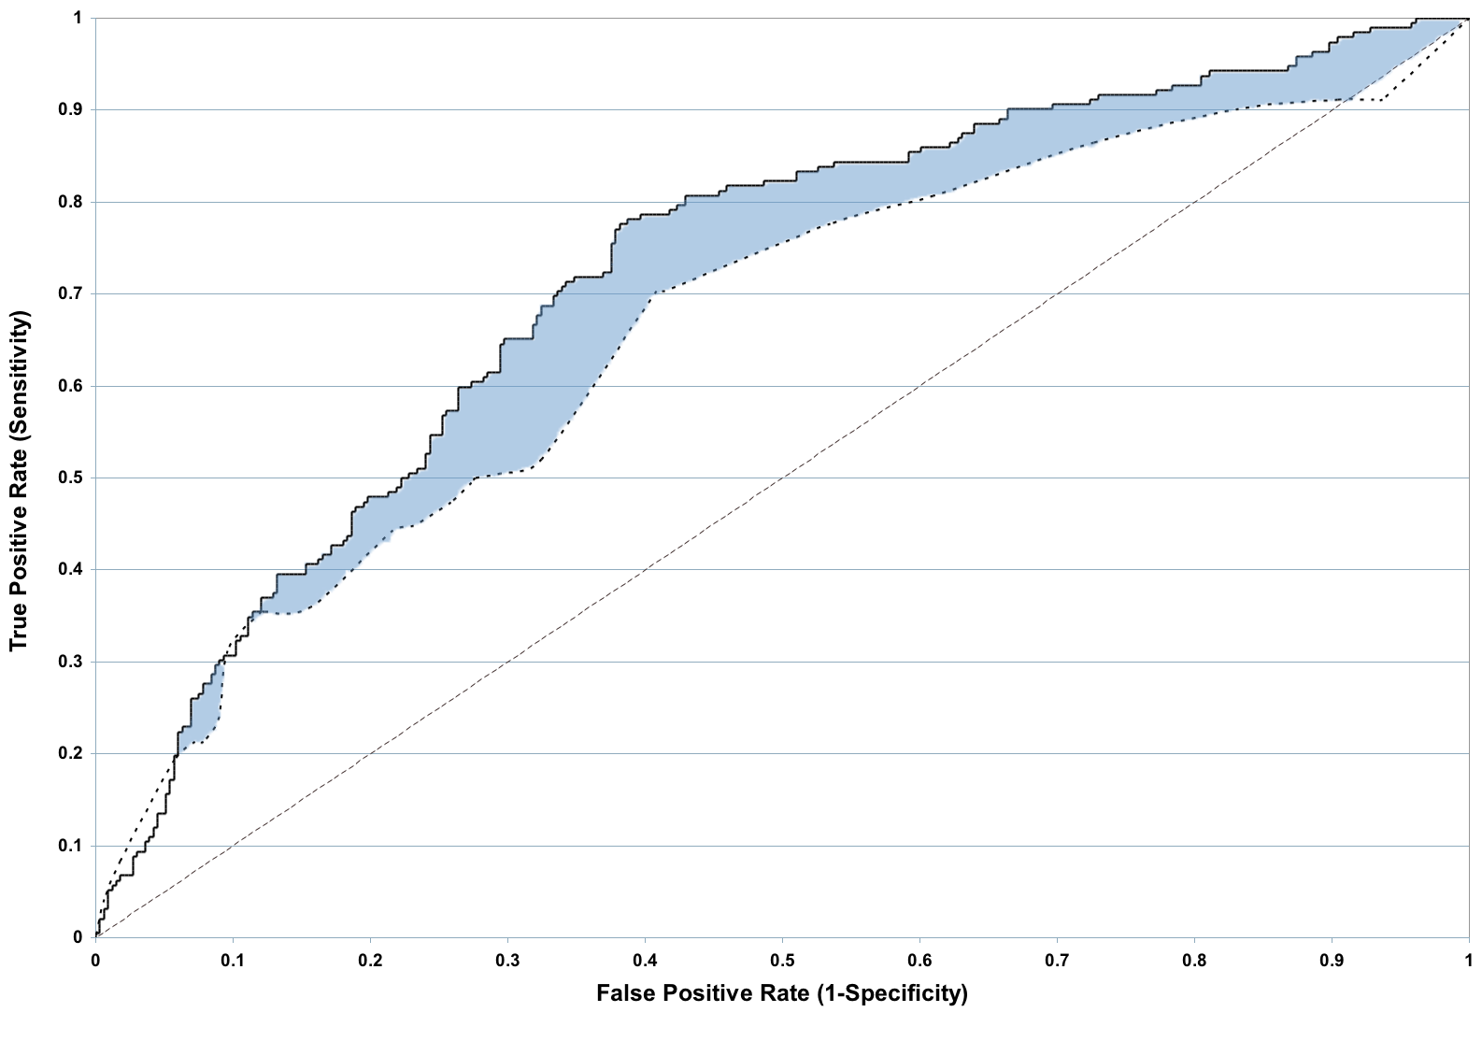
Validation Results
Clinical
Biological
Statistical
Our clinical trial
Discovery
Gene selection
Term selection
Model fitting
Results
Product
Clinical Factors + Algorithm
Δ AUC = 6%, p=.003
Clinical Factors

Slide 27
Validation Results
Clinical
Biological
Statistical
Our clinical trial
Discovery
Gene selection
Term selection
Model fitting
Results
Product
roc.plot.default (verification package)
rcorr.cens (Hmisc package)
boot (boot package)
roc.diff<-function(dat,i){
dat<-dat[i,]
out<-rcorr.cens(dat[,1],dat[,3])[1]-rcorr.cens(dat[,2],dat[,3])[1]
out
}
boot(data.frame(alg.score,clin.risk,QCA50),roc.diff,1000)

Slide 28
Clinical
Biological
Statistical
Our clinical trial
Discovery
Gene selection
Term selection
Model fitting
Results
Product
Algorithm Score
Single Vessel Disease
Multi-Vessel Disease*
sciplot package
lineplot.CI(dis.cat,alg.score,ci.fun= function(x) (c(mean(x)-1.96*se(x), mean(x)+1.96*se(x))),xlab="Percent Maximum Stenosis by QCA",
ylab="Algorithm Score",ylim=c(10,30),xlim=c(0,6))

Slide 29
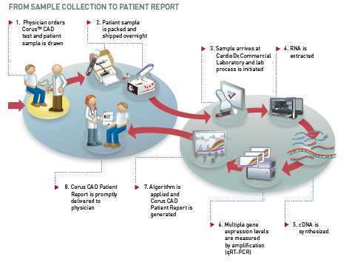
Commercial Laboratory
Clinical
Biological
Statistical
Our clinical trial
Discovery
Gene selection
Term selection
Model fitting
Results
Product
R functions for data processing, QC, and score calculation

Slide 30
Regulatory Issues
Clinical
Biological
Statistical
Our clinical trial
Discovery
Gene selection
Term selection
Model fitting
Results
Product
Molecular diagnostics are regulated by FDA and CLIA
Requirement for software ‘validation’
Simply means that software code must be developed and tested against a spec
Common misperception that this cannot be done in R (versus e.g. SAS)

Slide 32
Questions?

Slide 33
Corus™ CAD Intended Use
Corus™ CAD Intended Use
The Corus CAD test is a quantitative in vitro diagnostic test performed in a single laboratory, using the gene expression profile of cells found in peripheral blood specimens to be used as an aid to identify patients who are likely to have coronary artery stenosis of at least 50%. The test should be performed on patients with a history of chest pain, with suspected anginal equivalent to chest pain, or with a high risk of coronary artery disease, but with no known prior myocardial infarction or revascularization procedures. The test is not intended for patients with acute myocardial infarction, high risk unstable angina, systemic infectious or systemic inflammatory conditions, diabetes, and/or who are currently taking steroids, immunosuppressive agents, or chemotherapeutic agents. The test is performed on a blood specimen obtained from the patient. The test incorporates the expression levels of multiple genes using an algorithm with weighted functions to generate a quantitative score. The results of the test should be used by clinicians in conjunction with other tests and clinical information in their assessment of a patient’s coronary artery disease. The Corus CAD test is for prescription use only. The test is not intended to be used to screen for stenosis among patients who are asymptomatic and not considered at high risk for coronary artery disease, to predict or detect response to therapy, or to help select the optimal therapy for patients.

